Slide 1

Welcome to BookMyMandap: Your Dream Venue Awaits
Discover the hassle-free way to find and book Mandaps, designed to connect users and providers effortlessly. Our platform creates seamless event experiences by simplifying the entire venue booking journey.

Slide 2

The Problem: Traditional Venue Booking is a Headache
Time-Consuming Searches
Lack of Transparency
Pricing and venue availability remain unclear, frustrating users and providers alike.
Users spend over 40 hours navigating through scattered information, making endless phone calls to find a suitable Mandap.
Disorganized Process
Poor communication and outdated listings result in inefficient booking experiences.

Slide 3
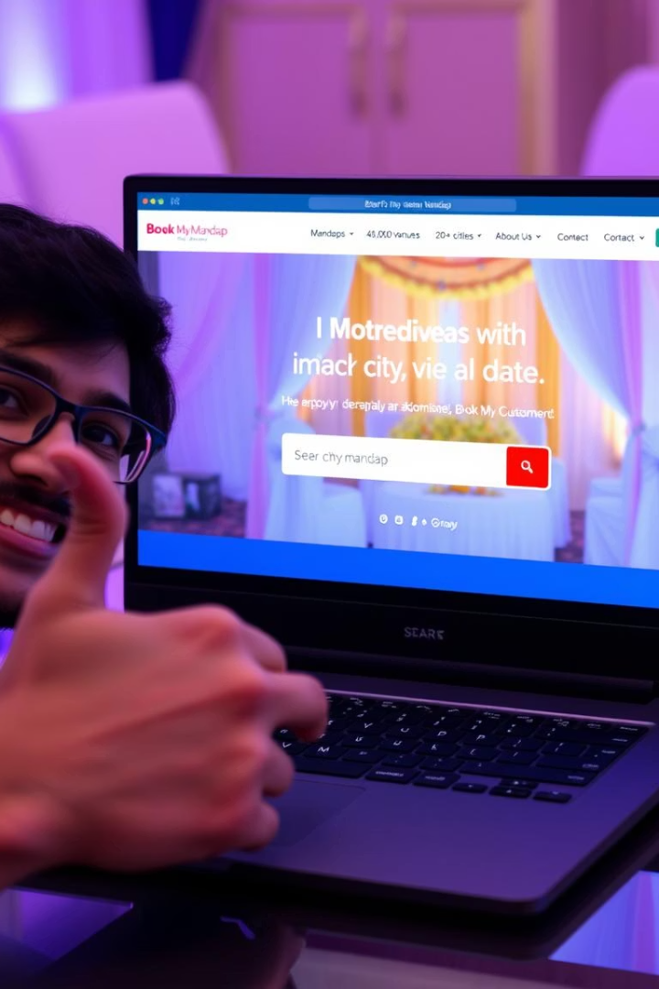
Our Solution: BookMyMandap - Simplifying Venue Booking
Unified Platform
Streamlined Experience
Connecting users directly with Mandap providers on a single easy-to-use platform.
Efficient search, booking, and management tools reduce time and effort.
Transparent & Organized
Clear pricing, availability, and secure transactions ensure trust and convenience.

Slide 4






For Users: Find and Book Your Perfect Mandap
Advanced Search
Filters by location, capacity, amenities, and price
Detailed Listings
High-quality photos, virtual tours, and detailed descriptions
Secure Booking
Secure online booking and payment processing
Trusted Insights
User ratings and reviews for trustworthy insights
Save Time
Save 20+ hours with an easy streamlined process

Slide 5
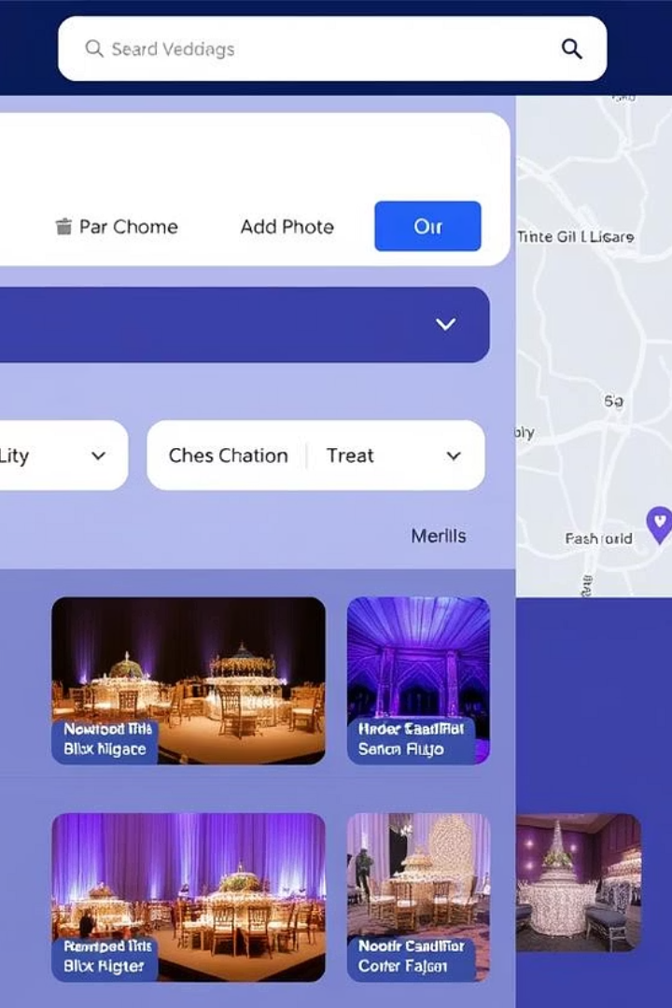
User Interface Example
The search results page offers both map and list views for convenience, showcasing mandap locations with essential details. Each venue profile features high-quality photos, comprehensive descriptions, and an easy booking button for seamless reservations.

Slide 6




For Providers: Showcase Your Mandap and Grow Your Business
Easy Listing Management
Direct Customer Communication
Create and update your Mandap listings effortlessly with user-friendly tools.
Engage directly with potential clients to answer questions and build trust.
Real-Time Availability
Boost Your Visibility
Keep your calendar up-to-date to prevent double bookings and manage your schedule smoothly.
Achieve an average 30% increase in booking inquiries through enhanced platform exposure.

Slide 7
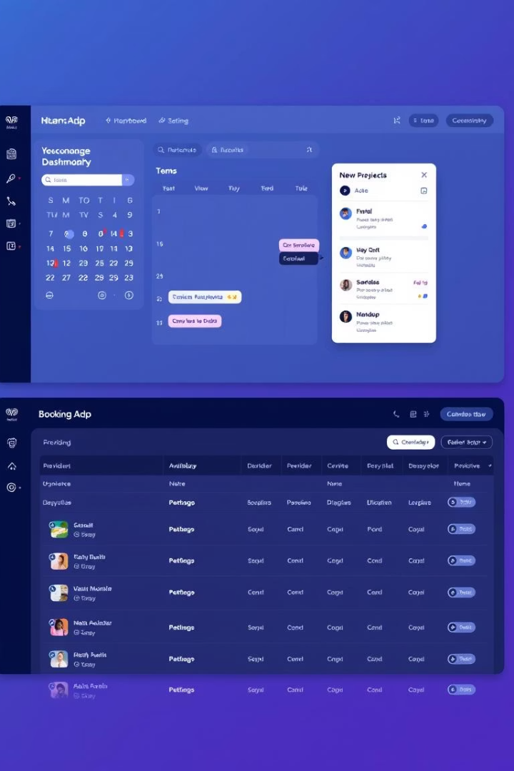
Provider Dashboard Example
The provider dashboard offers an intuitive interface to manage listings efficiently. Features include a real-time booking calendar to track availability and tools for direct communication with clients, fostering better engagement and business growth.

Slide 8

For Admins: Manage the Platform and Ensure Quality
Account Management
Quality Control
Security & Analytics
Admins efficiently oversee both users and providers to uphold the platform's integrity and smooth operation.
Rigorous approval processes and continuous monitoring guarantee the reliability and accuracy of all listings.
Advanced fraud detection, comprehensive security measures, and detailed analytics empower growth and trust.

Slide 9

Our Vision: The Future of Event Venue Booking
Expand Services
1
Add more event features to make one easy platform.
AI Recommendations
2
Use AI to give custom venue choices and help plan events.
Event Ecosystem
3
Create a full system for smooth event planning.
Market Leadership
4
Become the top Mandap booking platform by 2026.

Slide 10

BookMyMandap: Let's Create Unforgettable Events Together
Join thousands who trust BookMyMandap for effortless venue booking. Experience the future of event planning with convenience and confidence at your fingertips. Contact us today to learn how we can help make your special day truly unforgettable.

